Slide 1



Team: Carbon Captors
Projecting CCUS Project Requirements
Abid, Chahat, Javad, Marcelo, Michael, & Sarupa
Notes:
Welcome we are the carbon capture team and today we'll present our findings for the 2024 datathon competition.

Slide 2
01
Introduction
How much CCUS do we actually need by 2050?
Notes:
Given the numerous data sets we were given we decided to narrow our scopes and try to answer one question.
Are the current carbon capture, utilization, and storage projects (CCUS) able to effectively reduce the projected carbon emissions in the future.

Slide 3

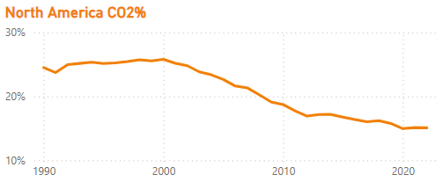
Study focus: North America
25% of world total CO2
In the last 30 years, North America has been responsible for over a quarter of total CO2 emitted to the atmosphere.
Notes:
As you know CO2 emissions have been rising globally, with North America contributing 25% of the world’s total emissions over the past 30 years. Addressing this is crucial in mitigating climate change.

Slide 4
Our Data Journey
Over ~10k data rows analyzed to select datasets
4 datasets to study CO2 emission and CCUS
Incorporated an additional dataset for emission targets
Data Collection
Data cleaning and augmentation
Remove nulls and data imputation for missing values
Feature engineering
Exploratory Data Analysis
Time series models (ARIMA, SARIMAX) for prediction
Divided the data set into two sets: a training and a testing
ML models
Feature selections using correlations for building model
Comparison of emission prediction and CCUS
Estimation of urgent CCUS projects to meet targets
Analysis
Notes:
To begin our journey we reviewed the numerous sources provided.
Eventually focusing on the CO2 emissions and CO2 reduction data. Aggregating data as need as one dataset was not sufficient to observe the full picture.
This data required extensive cleaning and augmentation.
Using this data, we could then construct a time-series models to forecast future emissions and assess the potential impact of carbon reduction projects.

Slide 5

02
Prediction Model
Notes:
Let’s take a look at our model creation

Slide 6
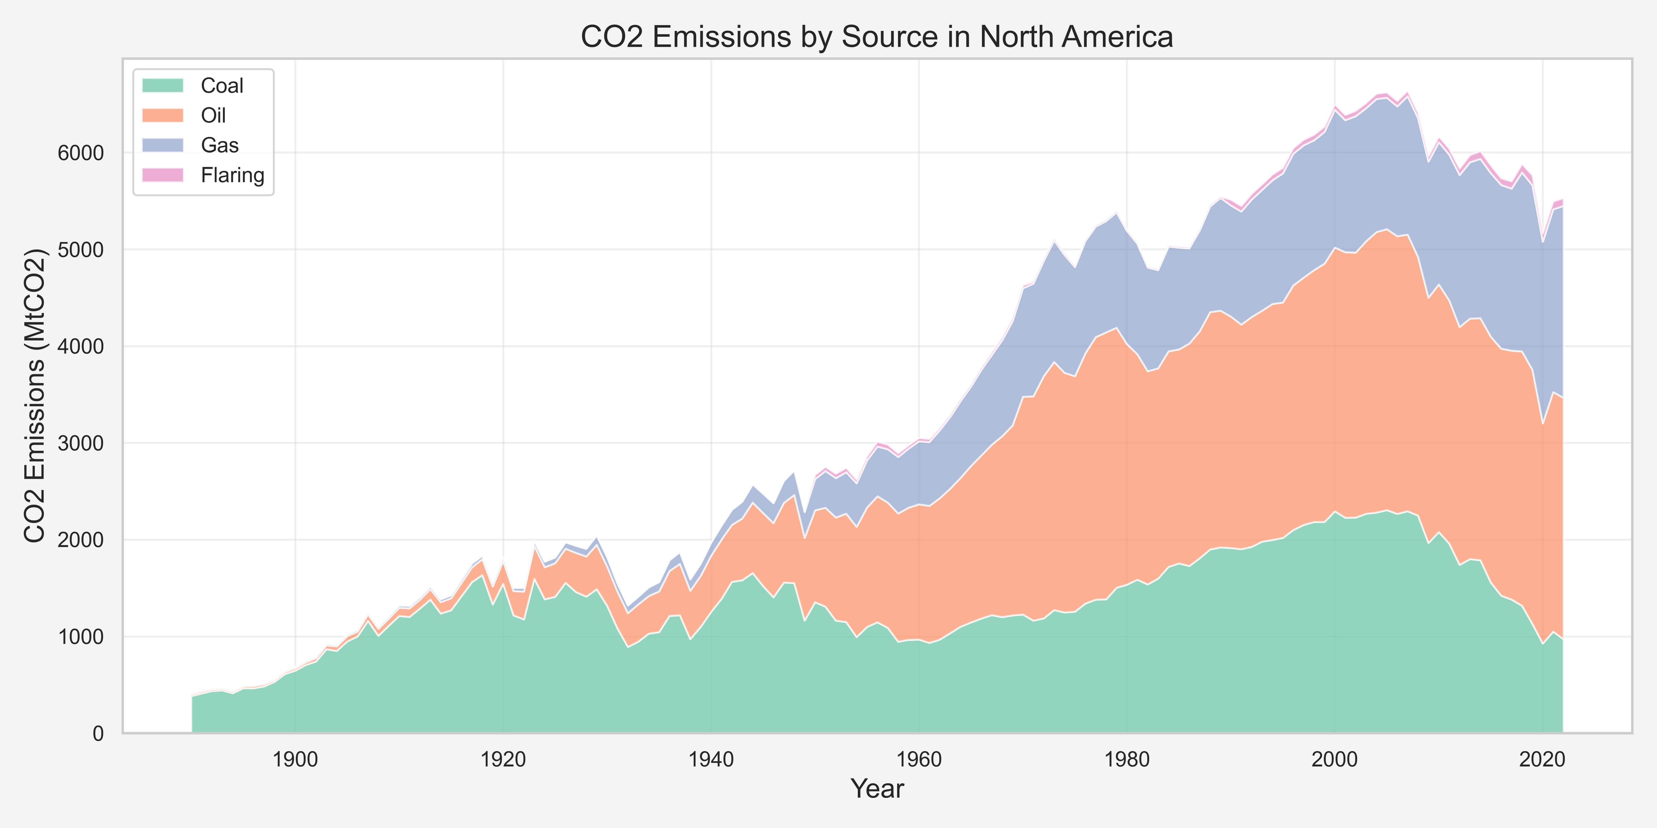
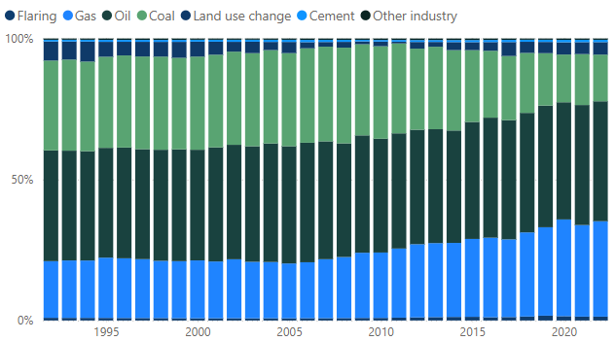
Emissions distribution in North America
Gas
COAL
Increased participation as energy transition vector
Continous reduction over time
Notes:
The CO2 data provided insights into annual emissions in North America, broken down by sector—such as coal, oil, gas, and flaring.
A key insight was the role that Gas has on the energy transition away from coal. As can be seen through the years less reliance of coal is observed.

Slide 7
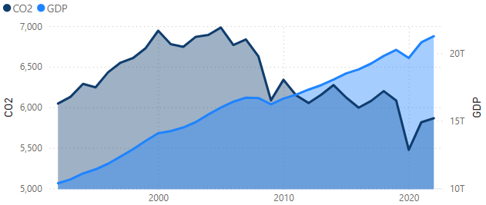
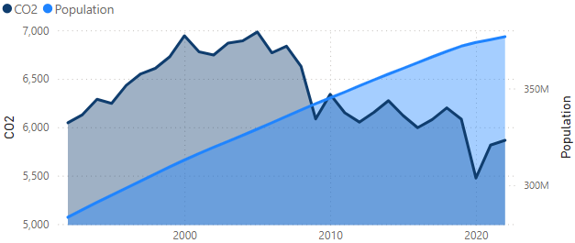
Emissions distribution in North America
Based on GDP
Based on Population
Since 2009, North America has seen a decoupling of GDP and population growth from CO2 emissions
Notes:
To enhance our model, we incorporated additional data such as GDP and population growth. These factors have a significant correlation with CO2 emissions, making them important variables in our prediction model.

Slide 8
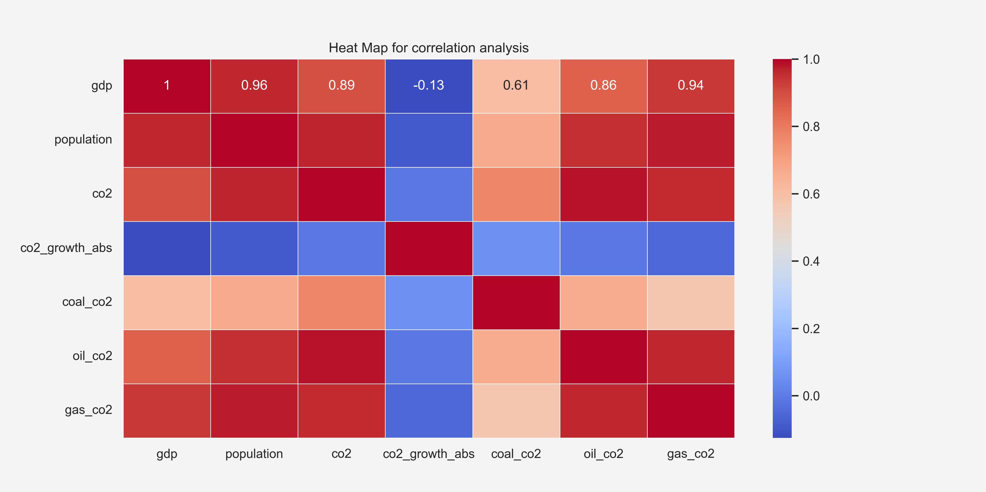
Correlation Analysis
Top three features are CO2 from Gas combustion, Population and GDP
Notes:
As seen in this heatmap, both population, and GDP show strong correlations with CO2 emissions. These variables were key in building our forecast model.

Slide 9
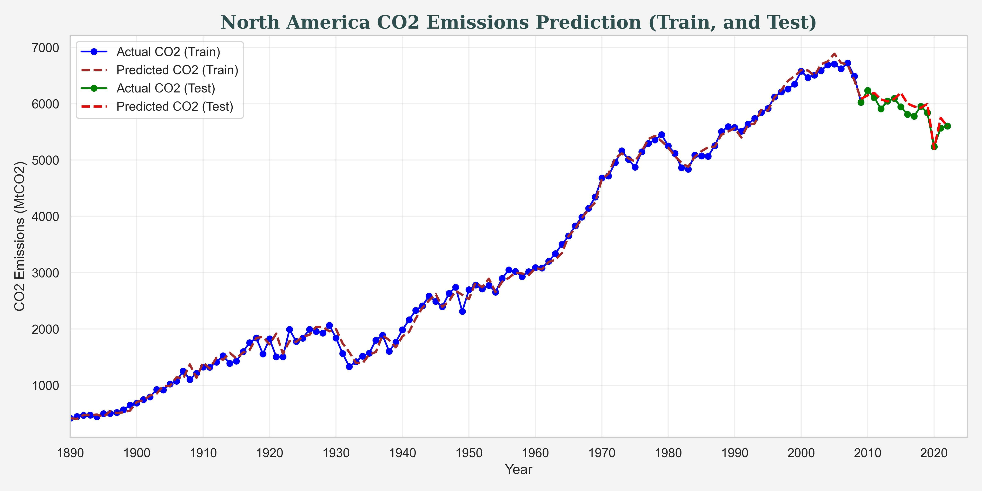
CO2 Emissions Prediction Model
 | Training | Testing
RMSE | 110.43 MtCO2 (3.22%) | 129.25 Mt (2.20%)
Notes:
After augmenting the data with the GDP and Population growth, a 90-10 training testing was created.
Different ML models were attempting, finally settling on a Seasonal ARIMA, as it was a popular method for time series analysis.
The model performed well with low error rate 3.22% and 2.2% for the training and testing data respectively.
SARIMA(Seasonal Autoregressive Integrated Moving Average) : SARIMA (Seasonal ARIMA) is a popular method in time series analysis for forecasting data with both trend and seasonal patterns. It combines three key components: autoregression (AR), differencing to handle non-stationarity (I), and moving average (MA), along with seasonal adjustments for periods. The mode inputs are GDP, Population and Annual CO₂ emissions from gas and output is CO2 emissions.

Slide 10
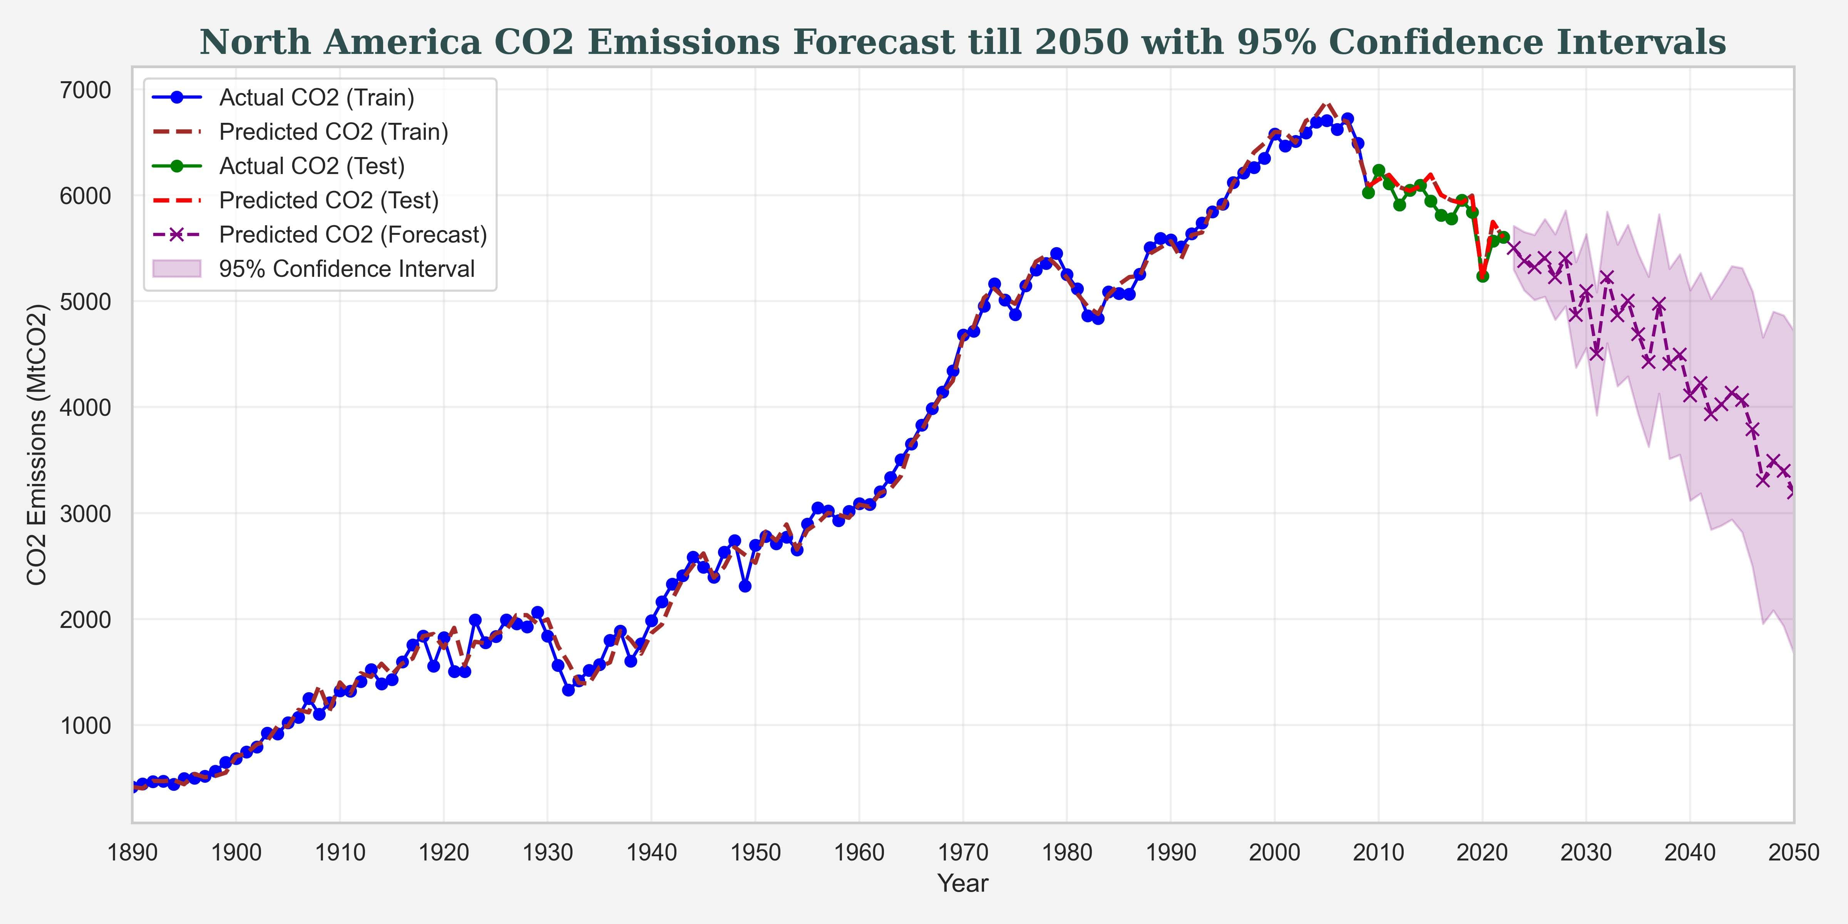
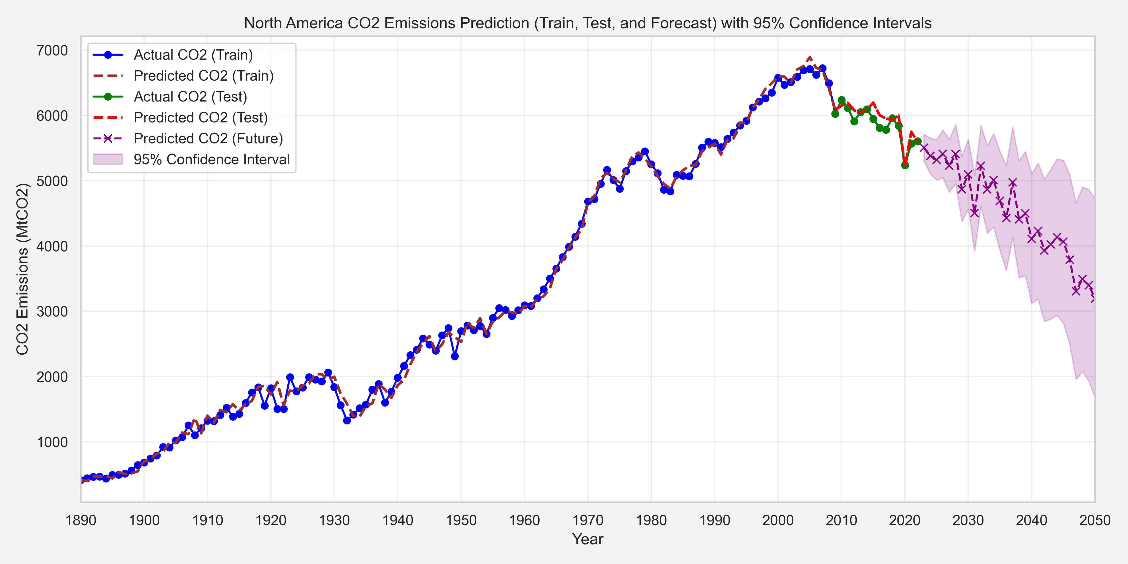
CO2 Emissions Forecast till 2050
Notes:
With confidence in our model, we predicted CO2 levels in North America through 2050, with a 95% confidence interval.
These projections provide a clear view of future emissions trends.
The general downward trends can show the affect of the current plans to reduce CO2 emissions in general.
1. Historical vs Predicted Emissions based on GDP, Population and Annual CO₂ emissions from gas: a close alignment between predicted and actual values and a reliable model performance, 2. Long term emission forecast and CI of prediction : a sharp downward trend leading up to 2050 and speed of the decline is uncertain
We don’t have the future input values (GDP, population, CO2 from Gas) so a projection was done based on the Rate (compond annual growth rate) this is typically used in GPD and growth estimations and we also used it for the CO2 from Gas
With confidence in our model, we predicted CO2 levels in North America through 2050, with a 95% confidence interval.
These projections provide a clear view of future emissions trends.
The general downward trends can show the affect of the current plans to reduce CO2 emissions in general.

Slide 11
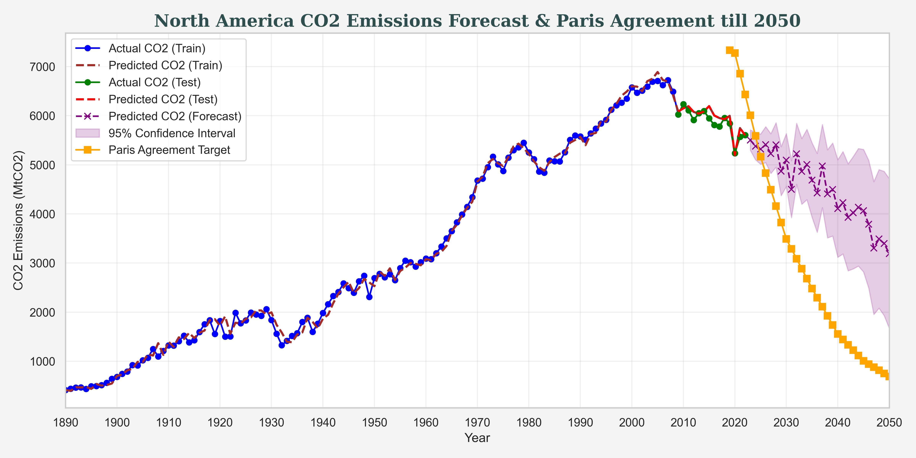
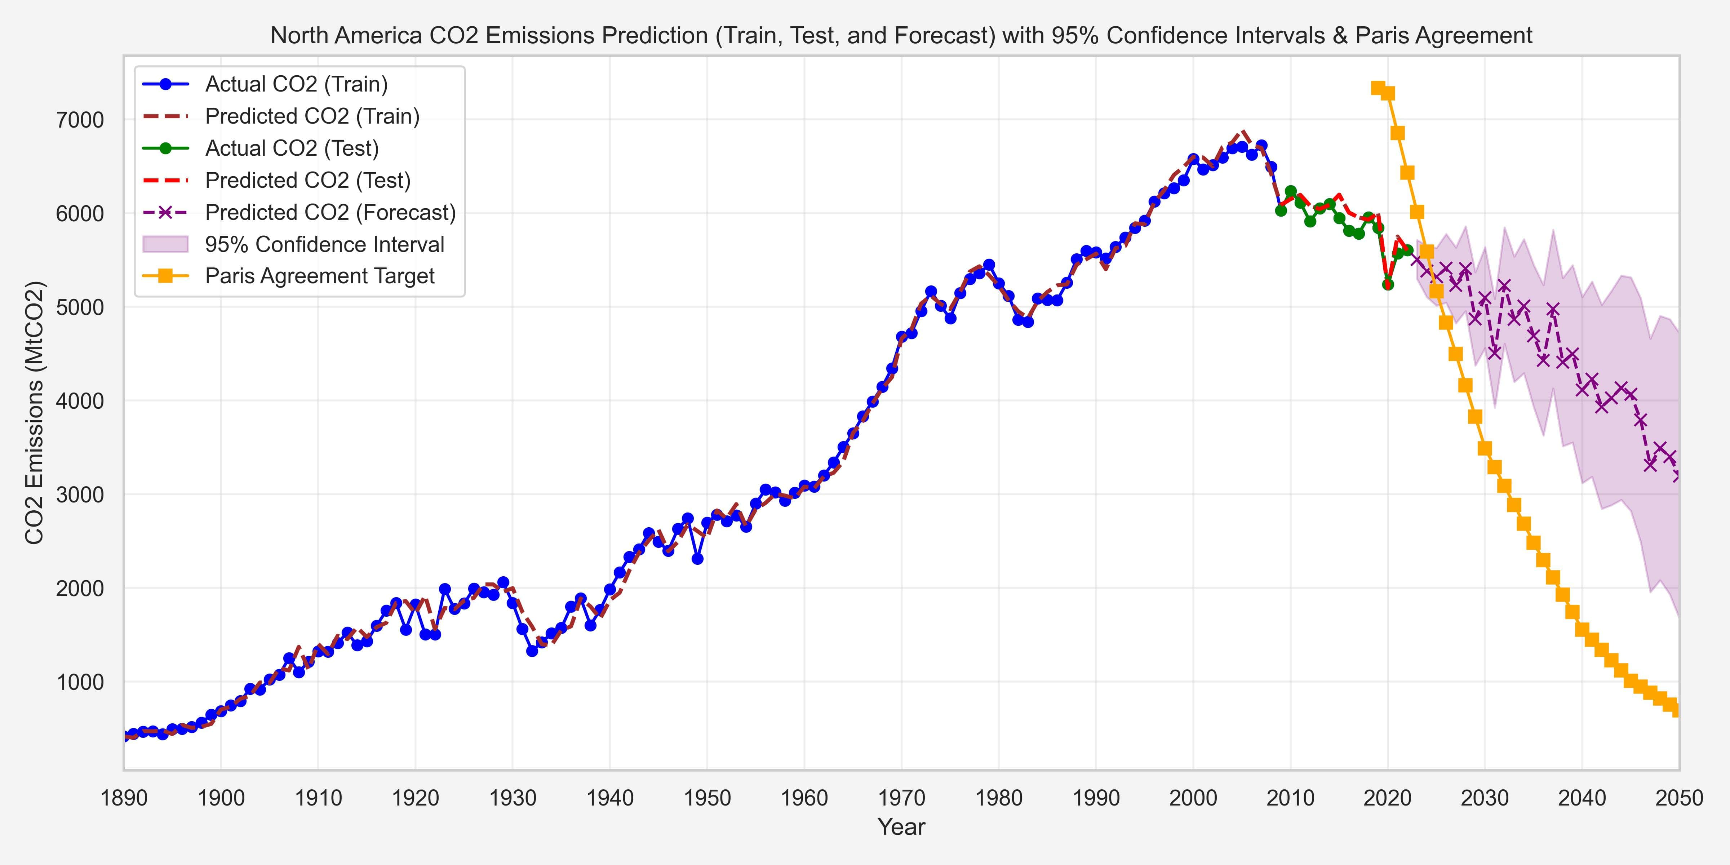
CO2 Forecast with Paris Agreement till 2050
Notes:
Sarupa will change the plot, add script: The Paris Agreement, adopted in 2015, aims to limit global warming to well below 1.5°C. The agreement encourages countries to set their own targets and to report on their progress regularly. The predicted CO2 emissions show a declining trend but they still remain above the levels needed to meet the Paris Agreement targets.
The provided a Temperature goal that was then later correlated to a CO2 equivalent that we should reach
The orange came from “climate action tracker” and NGO that gives a projection of where we should be to reach the Paris agreement goals
We compared our forecasts with the Paris Agreement targets, which aim to limit global warming to 1.5°C.
The data in orange is what CO2 levels would need to be in order to achieve this target.
Our analysis shows that CO2 levels will exceed the necessary reductions required to meet these goals, indicating the need for more aggressive action.

Slide 12
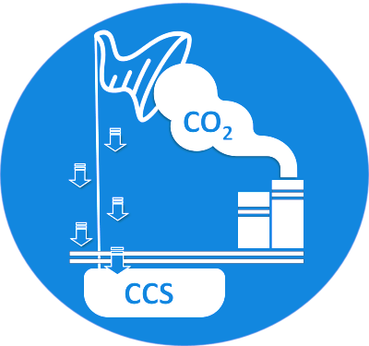
03
CCUS Data
Notes:
One potential for this are the Carbon capture, utilization, and storage projects

Slide 13
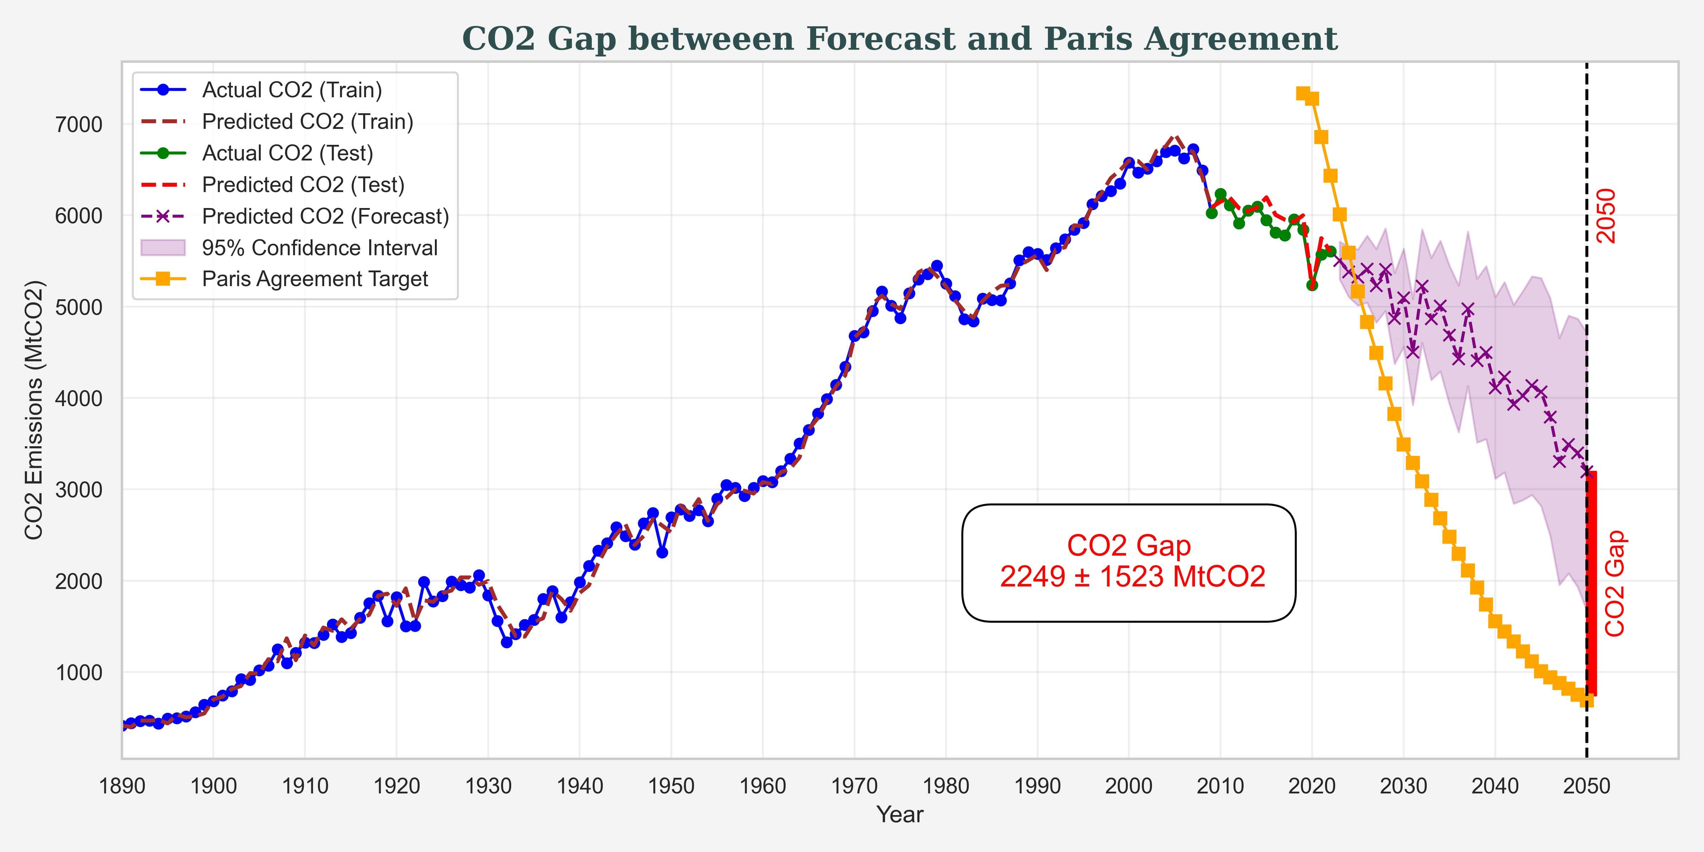
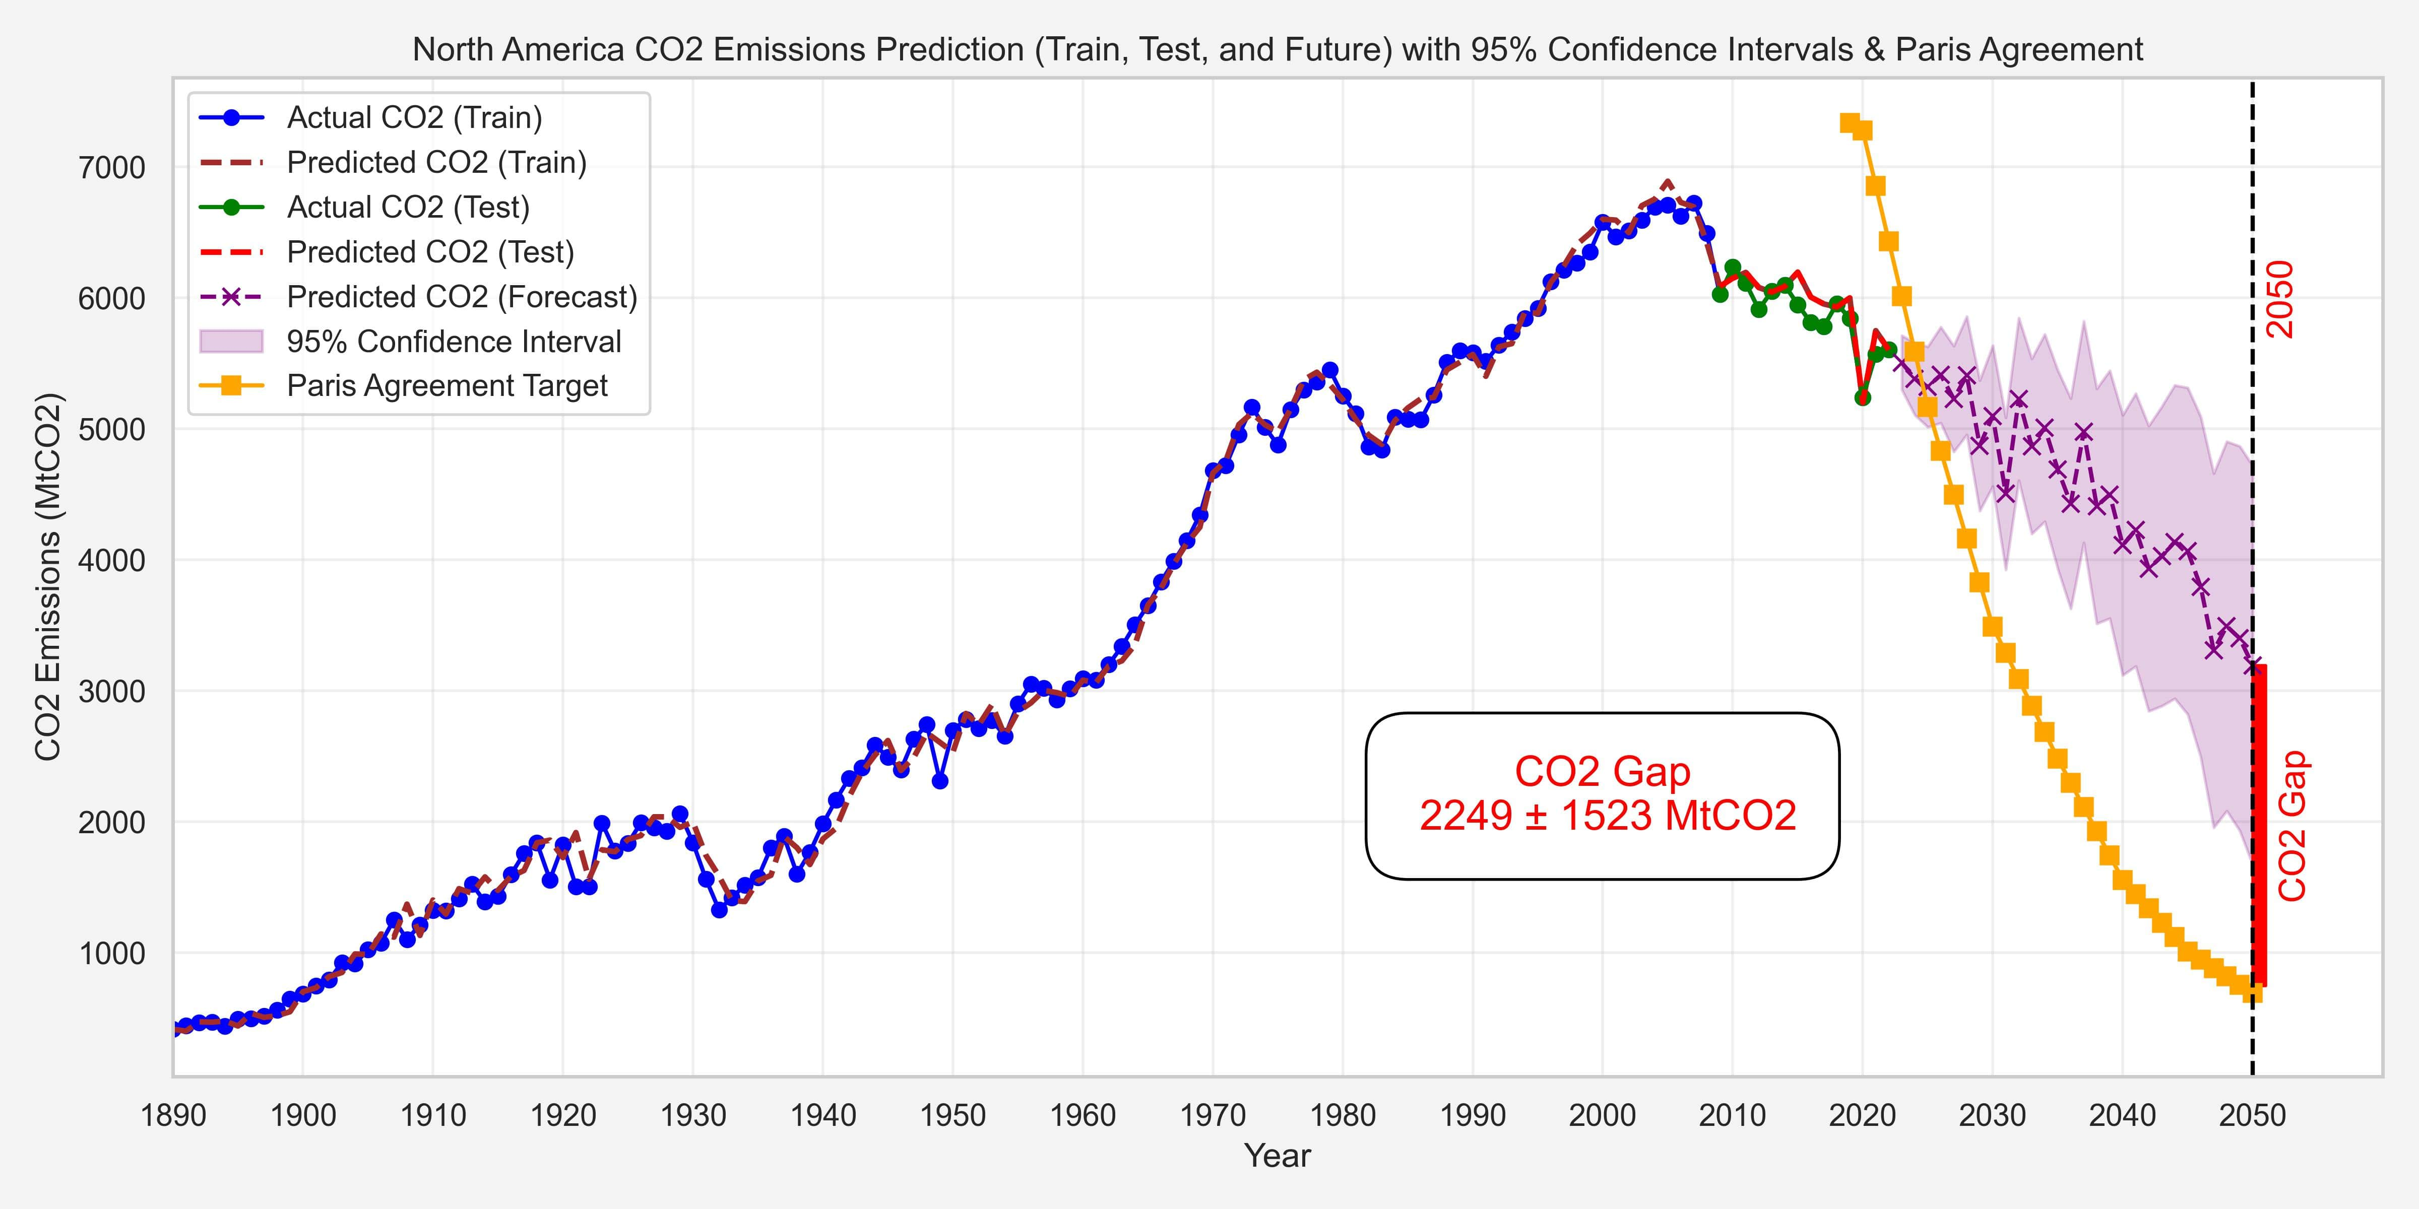
CCUS Requirement by 2050
CO2 Gap XXXX ± XXXX MtCO2/yr
Notes:
The gap between projected CO2 emissions and the Paris Agreement target is around 2250 million tons per year. CCUS projects will play a key role in bridging this gap.

Slide 14
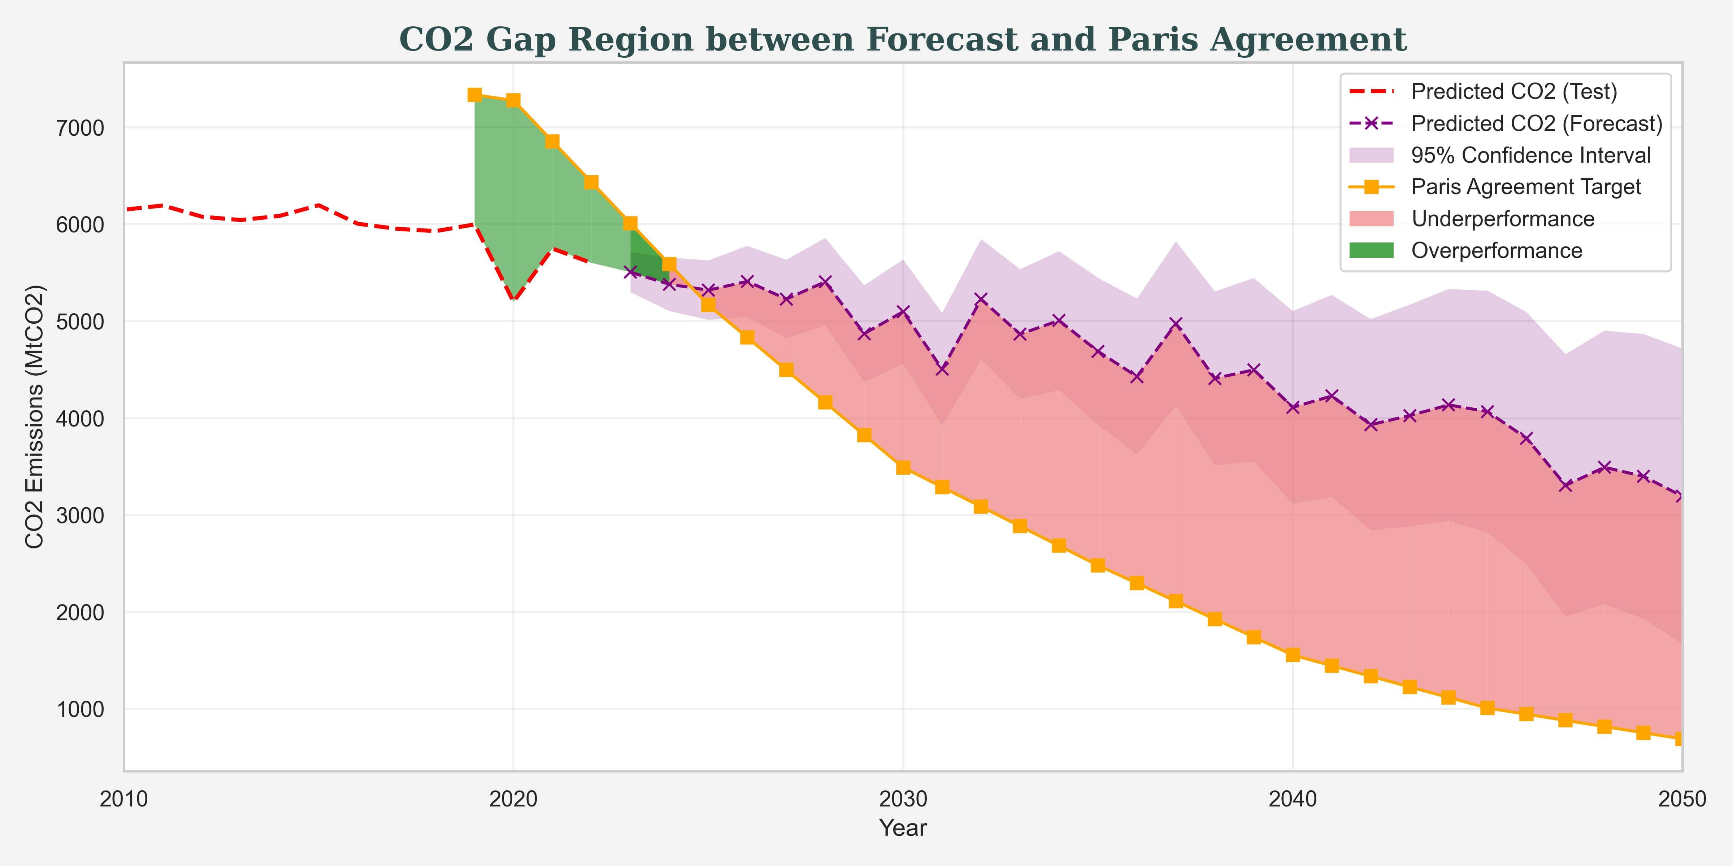
CO2 Gap Region
Notes:
Further analysis. The red dashed line shows CO2 emissions without mitigation, while the purple line reflects the impact of operational CCUS projects. Despite efforts, much of the forecasted emissions fall in the underperformance zone, shown in red, indicating we are not on track to meet the Paris targets.
This highlights the urgent need to scale up mitigation strategies to close this gap.

Slide 15
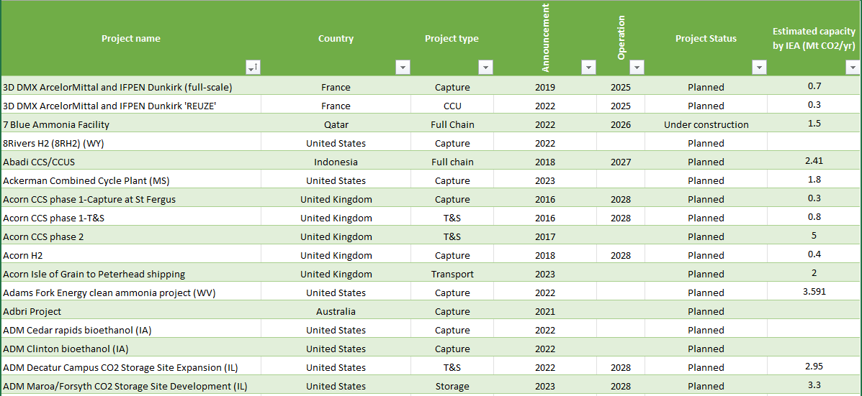
CCUS Projects Data
IEA CCUS Projects Database
Large-scale CO₂ capture, transport, storage, and utilization projects commissioned or planned worldwide
North American CCUS projects planned for operation
Notes:
We gathered data on North American CCUS projects, including project names, countries, start dates, and estimated CO2 capture capacities.
These were gathered from different datasets, and they show how many projects are being planned world wide and in North America
Javad: Modify the plots and comment
For the 4 datasets we found we combined this data

Slide 16
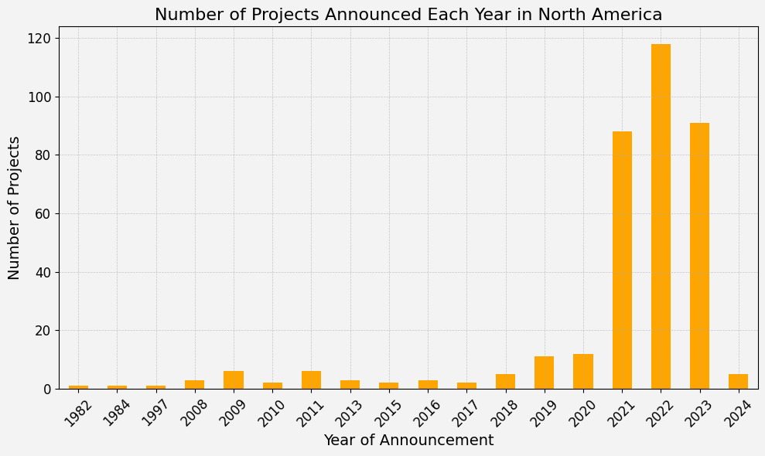
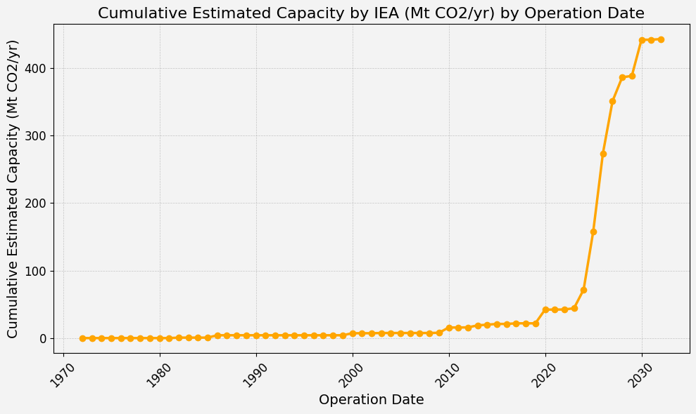
CCUS Projects Growth and Capacity in North America
Significant growth in North American CCUS projects and capacity, with a sharp increase since 2020.
Notes:
The number of CCUS projects has risen sharply since 2021. The cumulative capacity of these projects is estimated to capture 420 million tons of CO2 per year. But the question remains: Is this enough?

Slide 17
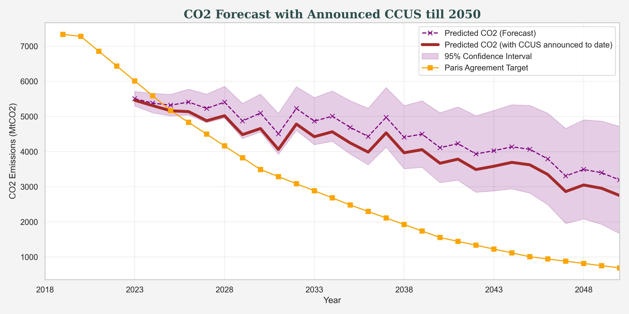
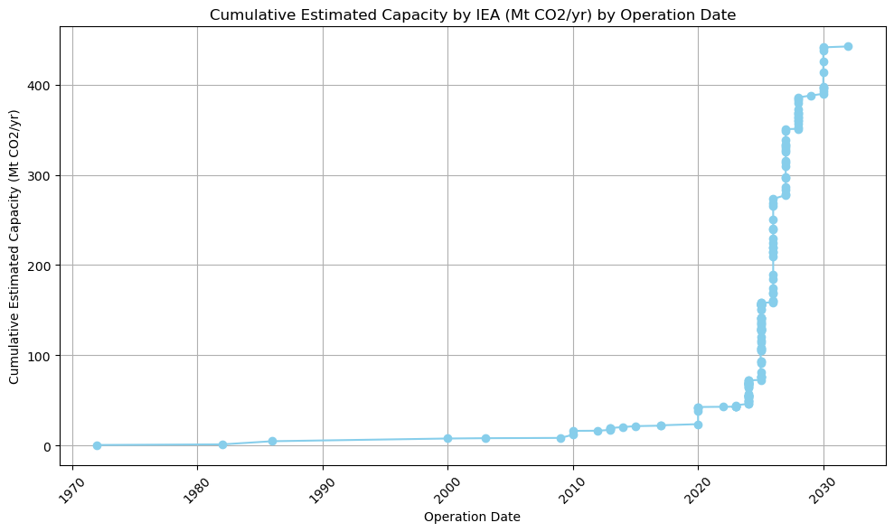


CCUS Requirement by 2050
CO2 Gap XXXX ± XXXX MtCO2/yr
Notes:
This graph provides a clear illustration of our findings. The purple dashed line represents our forecast for CO2 emissions in North America up to 2050, based on current data trends. When we factor in the impact of the announced CCUS projects, shown by the solid brown line, we see a noticeable reduction in projected emissions. However, this reduction is still far from sufficient to meet the Paris Agreement Target (represented by the yellow line).
The gap between the brown line and the orange line shows the shortfall in carbon capture efforts—current CCUS projects won’t be enough to achieve the necessary reduction of 2250 million tons of CO2 per year by 2050. This means that, while progress is being made, a much more aggressive expansion of CCUS projects is essential. Without additional projects, the Paris Agreement’s goal of keeping global warming below 1.5°C will remain out of reach.
This is our models estimate of how much CO2/yr emitted has not been removed by abatement or changing fossil fuel mix. Therefore, something else needs to be introduced to remove this “CO2 gap” and that something is CCUS
Purple is showing the affect of efficiencies, and general abaetment trend

Slide 18

04
Thoughts & Conclusion

Slide 19
2249 ± 1523 MtCO2/yr
858 ± 581 Projects
Estimated CCUS Requirement by 2050
Recommended Total Number of CCUS Projects till 2050
Average 2.62 MtCO2/yr per Project
Notes:
Given this gap, our analysis suggests that North America would need to commission approximately 860 additional CCUS projects with similar capacities to the ones announced to date. This is essential for bridging the 2250 million tons of CO2 shortfall by 2050. While the progress shown here is promising, the data clearly demonstrates that it is not enough.
Further, the timeline for getting these projects operational must be accelerated, and improvements in efficiency, technology, and scale are necessary. This graph highlights the critical need for concerted action across industries and governments to meet the Paris climate targets.

Slide 20

Thanks!
Do you have any questions?
marcelo@processecology.com
https://processecology.com
Notes:
As we've seen throughout this presentation, while we’ve made progress in reducing CO2 emissions and deploying carbon capture technologies, there’s still a significant gap between where we are and where we need to be to meet global climate goals.
However, there is still much we can do for this world. By working together, innovating, and accelerating efforts like CCUS and other mitigation strategies, we can move closer to achieving the targets set out in the Paris Agreement.
Thank you for listening.

